Slide 1

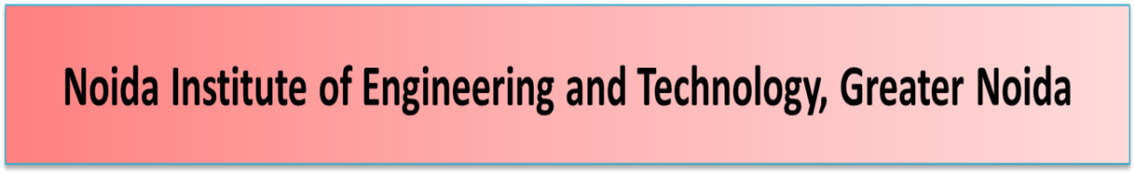


Statistical Process and Quality Control
Unit: 4
Subject Name – Total Quality Management
Faculty Name – Mr. Minhaj Nezami
Assistant Professor
Department - IT
Course – B. Tech 8th Sem

Slide 2

Course objectives
Course outcomes
Program Outcome
CO-PO Mapping
Program Specific Outcome
CO-PSO Mapping
Program Educational Objectives
Unit Recap and Precap
Syllabus of Unit 4
Statistical Process Control
Quality Function Deployment
Taguchi Quality Loss Function
Total Productive Maintenance
Daily quiz
Previous Year Question Papers

Slide 3


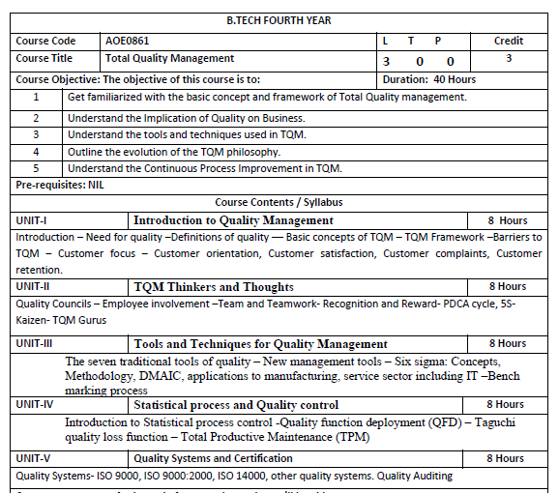

Slide 4

Objective of Reliability
Pre cap of Reliability
Reliability
Recap of Reliability
Daily quiz
Objective of PDCA
Pre cap of PDCA
PDCA.
Recap of PDCA
Daily quiz
Video links
Weekly assignments
MCQs
Old question papers
Expected questions for university exam
Summary

Slide 5

AOE0861.1 | To learn about common term Quality Concepts
AOE0861.2 | To know TQM principle
AOE0861.3 | To understand the importance of different chart like P-charts and C-charts
AOE0861.4 | Statistical Process Control and Total Productive Maintenance
AOE0861.5 | To be aware about different ISO standards and JIT

Slide 6




UNIT OBJECTIVE
Statistical Process and Quality Control

Slide 7

AOE0861.1 | Define the Quality Concepts and Manufacturing Quality
AOE0861.2 | Conceptualize the term Quality Management and relate to this various TQM Principles
AOE0861.3 | Analyze the different Tools and Techniques and Control Charts
AOE0861.4 | Statistical Process Control and Total Productive Maintenance
AOE0861.5 | Coordinate IS0 and its concept to Quality Management

Slide 8

1. Engineering knowledge
2. Problem analysis
3. Design/development of solutions
4. Conduct investigations of complex problems
5. Modern tool usage
6. The engineer and society
7. Environment and sustainability
8. Ethics
9. Individual and team work
10. Communication
11. Project management and finance
12. Life-long learning

Slide 9

CO | PO1 | PO2 | PO3 | PO4 | PO5 | PO6 | PO7 | PO8 | PO9 | PO10 | PO11 | PO12
AOE0861.1 | 3 | 3 | 2 | 2 | 1 | 2 | 2 | 1 | 1 | 1 | 2 | 3
AOE0861.2 | 3 | 3 | 3 | 3 | 2 | 2 | 2 | 1 | 1 | 1 | 2 | 3
AOE0861.3 | 3 | 3 | 2 | 3 | 3 | 2 | 2 | 1 | 2 | 1 | 2 | 3
AOE0861.4 | 3 | 2 | 3 | 2 | 2 | 2 | 2 | 1 | 2 | 1 | 3 | 3
AOE0861.5 | 3 | 2 | 3 | 2 | 2 | 2 | 2 | 1 | 2 | 1 | 2 | 3
Avg | 3 | 2.6 | 2.6 | 2.4 | 2 | 2 | 2 | 1 | 1.6 | 1 | 2.2 | 3

Slide 10

On successful completion of graduation degree, The computer Science & Engineering graduates will be able to:
PSO1: identify, analyze real world problems and design their ethical solutions using artificial intelligence, robotics, virtual/augmented reality, data analytics, block chain technology, and cloud computing.
PSO2: design and develop the hardware sensor devices and related interfacing software systems for solving complex engineering problems.
PSO3: understand inter-disciplinary computing techniques and to apply them in the design of advanced computing.
PSO4: conduct investigation of complex problem with the help of technical, managerial, leadership qualities, and modern engineering tools provided by industry sponsored laboratories.

Slide 11

CO | PSO1 | PSO2 | PSO3
AOE0861.1 | 3 | 2 | 3
AOE0861.2 | 3 | 2 | 2
AOE0861.3 | 3 | 2 | 3
AOE0861.4 | 3 | 3 | 3
AOE0861.5 | 3 | 2 | 3
Avg | 3 | 2.2 | 2.8

Slide 12

PEO 1: To have an excellent scientific and engineering breadth so as to comprehend, analyze, design and provide sustainable solutions for real-life problems using state-of-the-art technologies.
PEO 2: To have a successful career in industries, to pursue higher studies or to support entrepreneurial endeavors and to face the global challenges.
PEO 3: To have an effective communication skills, professional attitude, ethical values and a desire to learn specific knowledge in emerging trends, technologies for research, innovation and product development and contribution to society.
PEO 4: To have life-long learning for up-skilling and re-skilling for successful professional career as engineer, scientist, entrepreneur and bureaucrat for betterment of society.

Slide 13
UNIT RECAP AND PRECAP
RECAP
Quality control tools
Histogram
Check sheet
Ishikawa diagram
Pareto chart
PRECAP
1. Quality circle
2. Zero defect
3. Kaizen

Slide 14
SYLLABUS OF UNIT 4
Statistical Process and Quality Control
(TPM) Introduction to Statistical process control -Quality function deployment (QFD) – Taguchi quality loss function – Total Productive Maintenance

Slide 15
Objective of Statistical process control
The main objective of Statistical Process Control (SPC) is to ensure consistent quality by monitoring and controlling processes to minimize variation and prevent defects. It achieves this by using statistical techniques to detect deviations in real-time, allowing for immediate corrective action before faulty products are made. Key goals include improving quality, reducing costs from waste and rework, and increasing customer satisfaction.
CO | PO1 | PO2 | PO3 | PO4 | PO5 | PO6 | PO7 | PO8 | PO9 | PO10 | PO11 | PO12
AOE0861.1 | 3 | 2 | 3 | 2 | 2 | 2 | 2 | 1 | 2 | 1 | 3 | 3

Slide 16
Statistical Process Control
Statistical Process Control (SPC) is a data-driven methodology that uses statistical analysis to monitor, control, and improve manufacturing and other business processes. The primary goal is to ensure a process operates consistently and efficiently by identifying and addressing unusual variations in real-time.

Slide 17
Key Concept of SPC
Process variation: SPC is built on the principle that all processes have a degree of natural variation. This variation is classified into two types:
Common cause variation: Predictable, random fluctuations that are inherent to a stable process. This "background noise" indicates the process is in statistical control.
Special cause variation: Unpredictable, non-random variations caused by specific, identifiable external factors, such as machine failure, human error, or a new batch of materials.

Slide 18
UNIT OBJECTIVE
Prevention over detection: SPC focuses on proactively preventing defects by monitoring a process in real-time, rather than inspecting products after they have been made.
Control vs. specification limits: Control limits are calculated from the process's historical data and reflect its actual performance. Specification limits, in contrast, are the required boundaries set by customer or product design requirements.
Process capability: An analysis that evaluates whether a process is inherently capable of producing output that meets the customer's specified requirements.

Slide 19
Primary tools in SPC
Control charts: The most common tool in SPC, these charts visually plot data points over time, along with a centerline and upper and lower control limits. They help distinguish between common and special cause variation. Examples include:
X-bar charts: Monitor the process mean.
R charts: Monitor the process range (variation).
P-charts: Track the proportion of defective items.

Slide 20
Primary tools in SPC
Other key tools (the "7 Quality Control Tools"): SPC is often used with other quality tools for a comprehensive analysis.
Pareto charts: Prioritize the most significant factors contributing to a problem.
Histograms: Show the frequency distribution of process data.
Cause-and-effect (fishbone) diagrams: Visually illustrate the potential causes of an issue.
Scatter diagrams: Examine the relationship between two variables.
Check sheets: Simple, structured forms for collecting and analyzing data.
Stratification: Segments data from different sources to simplify pattern identification.

Slide 21
Benefits of using SPC
Reduced costs: Minimizes waste, rework, and warranty claims by catching problems early in the process.
Improved quality and productivity: Leads to more consistent products and optimizes processes, increasing overall efficiency.
Enhanced decision-making: Provides clear, data-driven insights into process performance rather than relying on guesswork.

Slide 22
Benefits of using SPC
Regulatory compliance: Helps document process stability, providing proof of robust quality procedures for audits.
Continuous improvement: Fosters a culture of ongoing process enhancement, a core component of management strategies like Six Sigma and Lean manufacturing

Slide 23
Benefits of using SPC
SPC is a foundational tool across many industries, including:
Manufacturing
Healthcare
Finance
Aerospace
Food production

Slide 24
QUALITY FUNCTION DEPLOYMENT
Quality Function Deployment is a planning tool used to fulfill customer expectations.
Quality Function Deployment focuses on customer expectations or requirements, often referred to as voice of the customer.
QFD TEAM :
There are two types of teams namely
1. Team for designing a new product
2. Team for improving an existing product

Slide 25
BENEFITS OF QFD
1. Improves Customer satisfaction
➢ Creates focus on customer requirements
➢ Uses competitive information effectively
➢ Prioritizes resources
➢ Identifies items that can be acted upon
2. Reduces Implementation Time
➢ Decreases midstream design changes
➢ Limits post introduction problems
➢ Avoids future development redundancies
3. Promotes Team Work
➢ Based on consensus
➢ Creates communication
➢ Identifies actions

Slide 26
BENEFITS OF QFD
4. Provides Documentation
➢ Documents rationale for design
➢ Adds structure to the information
➢ Adapts to changes (a living document)

Slide 27
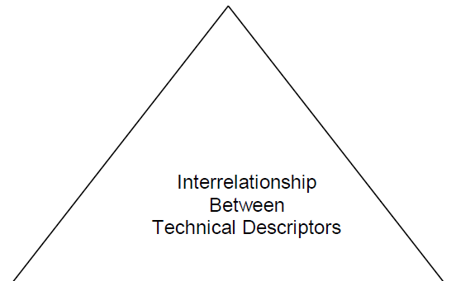
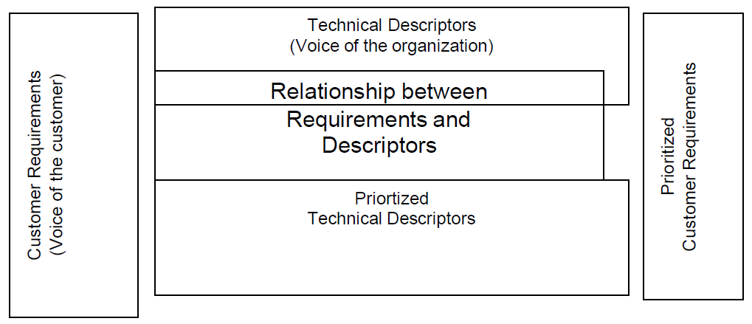
House of Quality

Slide 28
House of Quality

Slide 29
House of Quality
THE STEPS IN BUILDING A HOUSE OF QUALITY ARE :
1. List Customer Requirements (WHAT’s)
2. List Technical Descriptors (HOW’s)
3. Develop a Relationship Matrix Between WHAT’s and HOW’s
4. Develop an Inter-relationship Matrix between HOW’s
5. Competitive Assessments
a. Customer Competitive Assessments
b. Technical Competitive Assessments
6. Develop Prioritized Customer Requirements
7. Develop Prioritized Technical Descriptors

Slide 30
Taguchi Introduction
INTRODUCTION
Taguchi Methods is a statistical methods developed largely by GENICHI
TAGUCHI to improve quality of manufactured goods.
• The philosophy of off-line quality control.
• Innovations in the design of experiments.

Slide 31
Taguchi quality loss function
Taguchi Loss Function Definition
Taguchi defines Quality as “the loss imparted by the product to society from the time the
product is shipped.”
LOSS = Cost to operate,
Failure to function, maintenance and repair cost, customer satisfaction, poor design.
Product to be produced “being within specification”

Slide 32
Taguchi quality loss function
Taguchi’s Vs Traditional Approach
Taguchi’s Quadratic Quality Loss Function
Quality Loss Occurs when a product’s deviates from target or nominal value.
Deviation Grows, then Loss increases.
Taguchi’s U-shaped loss Function Curve.

Slide 33
Taguchi quality loss function
Formula to find Taguchi’s Loss Fn
Taguchi uses Quadratic Equation to determine loss Curve
L (x) = k (x-N)²
Where L (x) = Loss Function,
k = C/d² = Constant of proportionality,
where C – Loss associated with sp limit
d - Deviation of specification from target value
x = Quality Features of selected product,
N = Nominal Value of the product and
(x-N) = Tolerance

Slide 34
Taguchi quality loss function
Problem
A part dimension on a power tool is specified as 32.25±0.25.Company records show±0.25 exceeded & 75% of the returned fo replacement. Cost of replacement is Rs.12,500.Determine k & QLF.
Solution : Expected Cost of repair
C = 0.75(12500) = Rs 9,375
k = C/d²= 9375/(90.25)² = Rs 1,50,000
QLF =L (x) 1,50,00(x-N)

Slide 35
Taguchi quality loss function
Taguchi’s Quality Loss Function concept combines cost, target and variation in one metric with specifications being of secondary importance.
Taguchi has defined quality as the loss imparted to society from the time a product is shipped.
Societal losses include failure to meet customer requirements, failure to meet ideal performance and harmful side effects.

Slide 36
Taguchi quality loss function
CUSTOMERS PERCEIVE QUALITY AS MEETING THE TARGET RATHER THAN JUST MEETING THE SPECIFICATIONS.
There are three common quality loss functions
1. Nominal - the - best.
2. Smaller - the - better.
3. Larger - the - better.

Slide 37
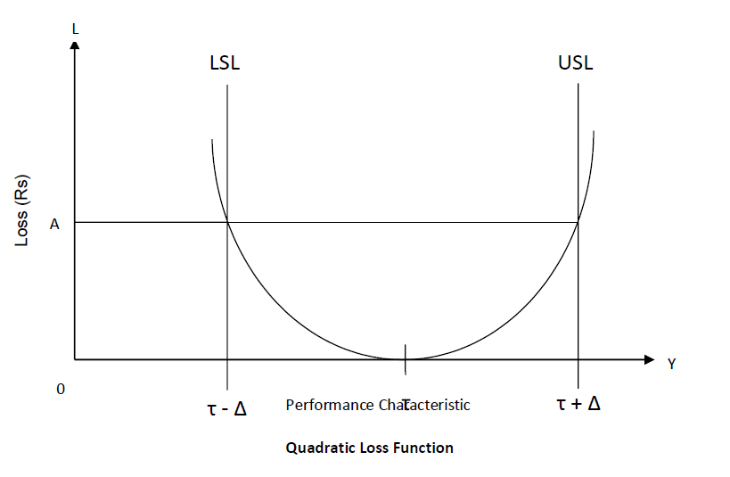
Taguchi quality loss function
4. NOMINAL – THE – BEST : Although Taguchi developed so many loss functions,
many situations are approximated by the quadratic function which is called the Nominal
– the – best type.

Slide 38
Taguchi quality loss function
The quadratic function is shown in figure. In this situation, the loss occurs as soon as the
performance characteristic, y, departs from the target τ.
At τ, the loss is Rs. 0.
At LSL (or) USL, the loss is Rs. A.
The quadratic loss function is described by the equation L = k (y - τ) 2.
Where,
L = cost incurred as quality deviates from the target.
y = Performance characteristic
τ = target
k = Quality loss coefficient.
The loss coefficient is determined by setting Δ = (y – τ), the deviation from the target. When Δ is
the USL (or) LSL, the loss to the customer of repairing (or) discarding the product is Rs. A.
Thus,
K = A / (y – τ)2 = A / Δ2 .

Slide 39
Taguchi quality loss function
SMALLER – THE – BETTER :
The following figure shows the smaller – the – better concepts.
The target value for smaller – the – better is 0. There are no negative values for the performance characteristic.
The radiation leakage from a microwave appliance, the response time for a computer, pollution from an automobile, out of round for a hole etc. are the performance characteristics for this concept.

Slide 40
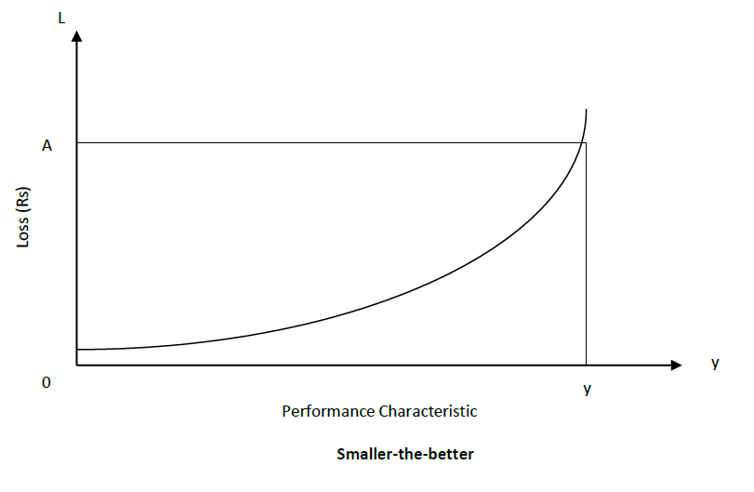
Taguchi quality loss function
LARGER – THE – BETTER :
The following figure shows the concept of the Larger – the – better.

Slide 41
Total Productive Maintenance (TPM)

Slide 42
Total Productive Maintenance (TPM)
Total Productive Maintenance (TPM) is defined as keeping the running plant and equipment at its highest productive level with the co-operation of all areas of the organization.
Predictive and Preventive maintenance are essential to building a foundation for a successful TPM environment. Predictive Maintenance is the process of using data and statistical Loss (Rs) tools to determine when a piece of equipment will fail. Preventive Maintenance is the process of periodically performing activities such as lubrication on the equipment to keep it running.

Slide 43
Total Productive Maintenance (TPM)
OBJECTIVES OF TPM :
1. To maintain and improve equipment capacity.
2. To maintain equipment for life.
3. To use support from all areas of the operation.
4. To encourage input from all employees.
5. To use teams for continuous improvement.

Slide 44
Total Productive Maintenance (TPM)
TPM PHILOSOPHY – CONCEPT OF TPM :
Total Productive Maintenance (TPM) is an extension of the Total Quality Management (TQM) philosophy to the maintenance function.
TPM has the following steps:
1. Management should learn the new philosophy of TPM.
2. Management should promote the new philosophy of TPM.
3. Training should be funded and developed for everyone in the organization.
4. Areas of needed improvement should be identified.
Loss measurements to identify improvement needs are
▪ Down time losses
▪ Reduced speed losses
▪ Poor quality losses
5. Performance goals should be formulated.
6. An implementation plan should be developed.
7. Autonomous worth groups should be established.

Slide 45
FAILURE MODE AND EFFECTS ANALYSIS (FMEA)
FMEA is an analytical technique that combines the technology and experience of people in identifying foreseeable failure modes of a product or process and planning for its elimination.
FMEA is a “before-the-event” action requiring a team effort to easily and inexpensively alleviate changes in design and production.
It is a group of activities comprising the following :
1. Recognize the potential failure of a product or process.
2. Identify actions that eliminate / reduce the potential failure.
3. Document the process.
Two important types of FMEA are
➢ Design FMEA
➢ Process FMEA

Slide 46
FAILURE MODE AND EFFECTS ANALYSIS
There are several types of FMEA : design FMEA, process FMEA, equipment FMEA, maintenance FMEA, concept FMEA, service FMEA, system FMEA, environmental FMEA, and others.

Slide 47
FAILURE MODE AND EFFECTS ANALYSIS
Failure Mode
A Failure Mode is:
⚫ The way in which the component, subassembly, product, input, or process could
fail to perform its intended function
⚫ Failure modes may be the result of upstream operations or may cause
downstream operations to fail
⚫ Things that could go wrong
Why
⚫ Methodology that facilitates process improvement
⚫ Identifies and eliminates concerns early in the development of a process or design
⚫ Improve internal and external customer satisfaction
⚫ Focuses on prevention
⚫ FMEA may be a customer requirement
⚫ FMEA may be required by an applicable Quality System Standard

Slide 48
FAILURE MODE AND EFFECTS ANALYSIS
INTENT OF FMEA :
➢ Continually measuring the reliability of a machine, product or process.
➢ To detect the potential product - related failure mode.
➢ FMEA evaluation to be conducted immediately following the design phase.

Slide 49
FAILURE MODE AND EFFECTS ANALYSIS
BENEFITS OF FMEA:
Having a systematic review of components failure modes to ensure that any
failure produces minimal damage.
➢ Determining the effects of any failure on other items.
➢ Providing input data for exchange studies.
➢ Determining how the high-failure rate components can be adapted to high-
reliability components.
➢ Eliminating / minimizing the adverse effects that failures could generate.
➢ Helping uncover the misjudgements, errors etc.
➢ Reduce development time and cost of manufacturing.

Slide 50
FAILURE MODE AND EFFECTS ANALYSIS
Methodology used for FMEA
FMEA Procedure
1. For each process input (start with high value inputs), determine the ways in which the
input can go wrong (failure mode)
2. For each failure mode, determine effects
⚫ Select a severity level for each effect
3. Identify potential causes of each failure mode
⚫ Select an occurrence level for each cause
4. List current controls for each cause
⚫ Select a detection level for each cause
5. Calculate the Risk Priority Number (RPN)
6. Develop recommended actions, assign responsible persons, and take actions
⚫ Give priority to high RPNs
⚫ MUST look at severities rated a 10
7. Assign the predicted severity, occurrence, and detection levels and compare RPNs

Slide 51
FAILURE MODE AND EFFECTS ANALYSIS
FMEA Inputs and Outputs
Severity,Occurrence, and Detection
o Severity
• Importance of the effect on customer requirements
o Occurrence
• Frequency with which a given cause occurs and
creates failure modes
o Detection
• The ability of the current control scheme to detect
or prevent a given cause

Slide 52
FAILURE MODE AND EFFECTS ANALYSIS
Rating Scales
⚫ There are a wide variety of scoring “anchors”, both quantitative or qualitative
⚫ Two types of scales are 1-5 or 1-10
⚫ The 1-5 scale makes it easier for the teams to decide on scores
⚫ The 1-10 scale may allow for better precision in estimates and a wide
variation in scores (most common)
⚫ Rating Scales
⚫ Severity
1 = Not Severe, 10 = Very Severe
⚫ Occurrence
1 = Not Likely, 10 = Very Likely
⚫ Detection
1 = Easy to Detect, 10 = Not easy to Detect
⚫ Risk Priority Number (RPN)
RPN is the product of the severity, occurrence, and detection scores.

Slide 53
FAILURE MODE AND EFFECTS ANALYSIS
Explain with an example Process FMEA document.
Process FMEA is an analytical Technique utilized by a manufacturing Responsible Engineering Team as a means to assure that , to the extent possible, potential failure modes and associated causes /mechanisms have been considered and addressed.

Slide 54
FAILURE MODE AND EFFECTS ANALYSIS
FMEA TEAM :
Engineers from- Assembly- Manufacturing- Materials - Quality - Service- Supplier-Customer.
FMEA DOCUMENTATION :
The purpose of FMEA documentation is
➢ To allow all involved Engineers to have access to others thoughts
➢ To design and manufacture using these collective thoughts (promotes team
approach)

Slide 55
DAILY QUIZ
The main objective of SPC is to maintain process _______. A) Profit B) Stability C) Inventory D) Workforce
Control charts are graphical tools used for process _______. A) Prediction B) Forecasting C) Monitoring D) Expansion

Slide 56
DAILY QUIZ
Variation in SPC is classified as common cause and _______ cause. A) Special B) Hidden C) Systematic D) Random
The center line of an X̄ chart represents the process _______. A) Range B) Mean C) Limit D) Mode
A process that operates within control limits is considered to be in _______. A) Failure B) Control C) Tolerance D) Instability

Slide 57
DAILY QUIZ
QFD translates customer needs into product _______. A) Specifications B) Expenses C) Packaging D) Marketing plans
The main matrix used in QFD is known as the House of _______. A) Value B) Quality C) Design D) Production
QFD enhances communication between marketing, design, and _______ departments. A) Sales B) Maintenance C) Manufacturing D) Transport

Slide 58
DAILY QUIZ
The primary benefit of QFD is reduction in design _______. A) Errors B) Changes C) Meetings D) Documents
The main focus of QFD is customer _______. A) Expectation B) Satisfaction C) Feedback D) Data

Slide 59
DAILY QUIZ
Taguchi’s philosophy defines quality as minimal _______ from target. A) Defects B) Deviation C) Variation D) Time
Quality loss increases in a _______ manner with deviation from target. A) Linear B) Quadratic C) Constant D) Irregular
The Taguchi method improves product _______ through robust design. A) Durability B) Reliability C) Cost D) Shape

Slide 60
DAILY QUIZ
TPM aims for zero breakdowns, zero defects, and zero _______. A) Waste B) Inventory C) Delay D) Effort
Autonomous maintenance involves operator _______ in routine upkeep. A) Avoidance B) Participation C) Absence D) Training only
TPM includes eight pillars such as planned maintenance and _______ improvement. A) Technical B) Focused C) Minor D) Partial

Slide 61
FACULTY VIDEO LINKS, YOUTUBE & NPTEL VIDEO LINKS AND ONLINE COURSES DETAILS
https://www.youtube.com/watch?v=Q3EOCAuExJU
https://www.youtube.com/watch?v=yWlAOFs04go
https://www.youtube.com/watch?v=QifqIoUNTJM
https://www.youtube.com/watch?v=qb3mvJ1gb9g
https://www.youtube.com/watch?v=2ePeXePNLrs
https://www.youtube.com/watch?v=HkdoR-NNEoI
https://www.researchgate.net/publication/318654507_Total_Quality_Management_Notes
http://www.mescenter.ru/images/abook_file/Total_Quality_Management_and_Six_Sigma.pdf

Slide 62
WEEKLY ASSIGNMENT
What is QFD?
What do you mean by House of Quality?
What are the four phases of product development in QFD process?
What are Taguchi methods?
What are the objectives of TPM.
Explain the House of Quality matrix and its components.

Slide 63
MCQ
1. What is meant by Kaizen?
a. card signal b. to avoid inadvertent errors c. change for better quality d. none of the above
2. Match the following group 1 items with group 2 items 1. Sort -------------------------------------------------- A. Seitan 2. Set in order ---------------------------------------- B. Seiketsu 3. Shine ------------------------------------------------ C. Seiri 4. Standardize ---------------------------------------- D. Seiso
a. 1 – D, 2 – A, 3 – B, 4 – C b. 1 – C, 2 – A, 3 – D, 4 – B c. 1 – B, 2 – C, 3 – A, 4 – D d. 1 –A, 2 – C, 3 – D, 4 – B

Slide 64
MCQ
3. What is meant by P, D, S and A in PDSA cycle?
a. Progress Development Study Act
b. Plan Do Study Act
c. Project Development Study Act
d. Prevention Do Study Act
4. Plan-Do-Check -Act cycle is related to:
a. Donabedian
b. Deming
c. Henry Gantt
d. None of these

Slide 65
MCQ
4. Match The Following
A. TQM promotes 1. Small change
B. Kaizen is 2. Continuous improvement
C. Quality circle can solve 3. Employee participation
problem related to
D. Quality circle benefit to 4. Employee
5. The correct order is
A-3, B-1, C-2, D-4
A-1, B-3, C-2, D-4
A-3, B-1, C-4, D-2
A-3, B-2, C-1, D-4

Slide 66
MCQ
6. Reliability of product means
Consistency of performance
Performance over period
Free of technical errors
The correct answer is
i & iii
i & ii
ii & iii
i, ii & iii
7. According to Deming, Quality problems are
a. Due to management
b. Due to method
c. Due to machine
d. Due to material

Slide 67
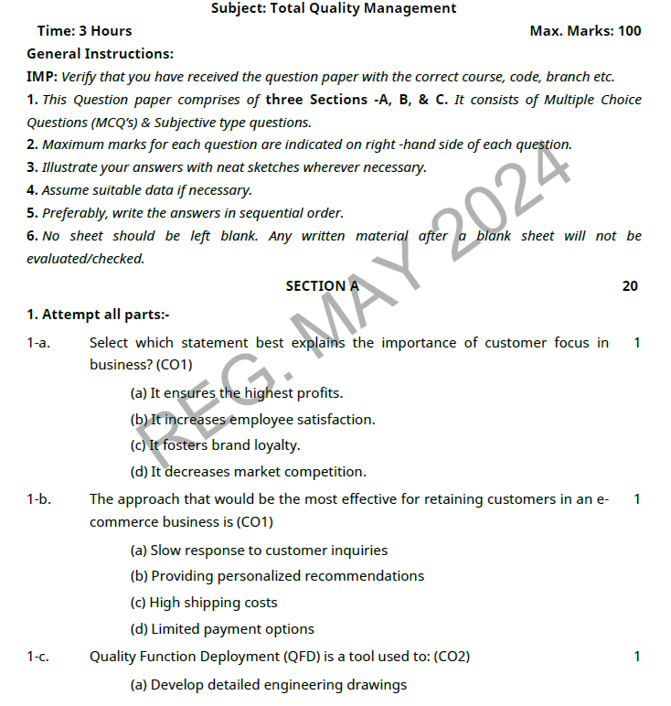
OLD QUESTION PAPERS

Slide 68
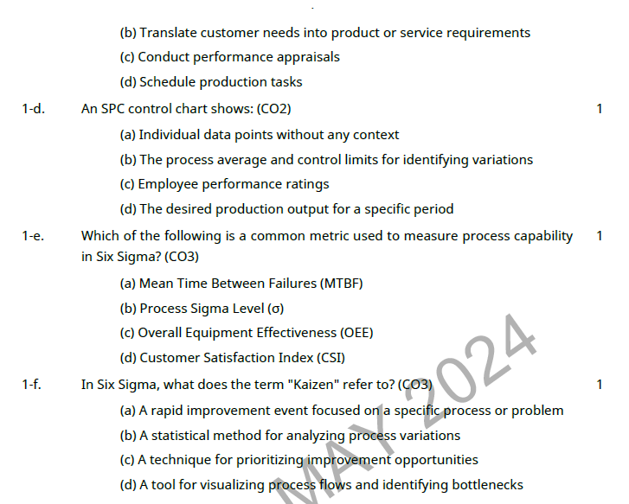
OLD QUESTION PAPERS

Slide 69
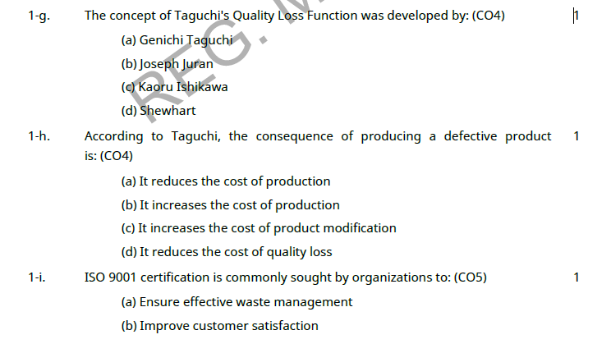
OLD QUESTION PAPERS

Slide 70
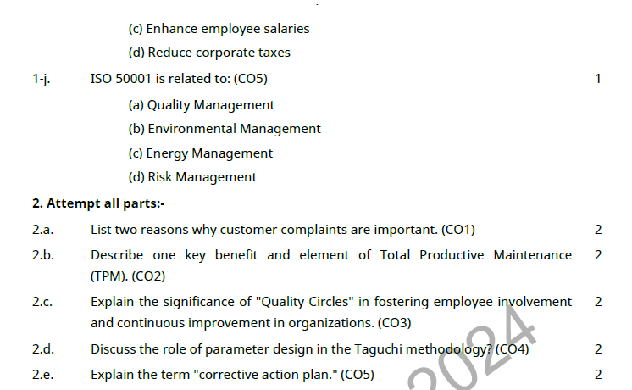
OLD QUESTION PAPERS

Slide 71
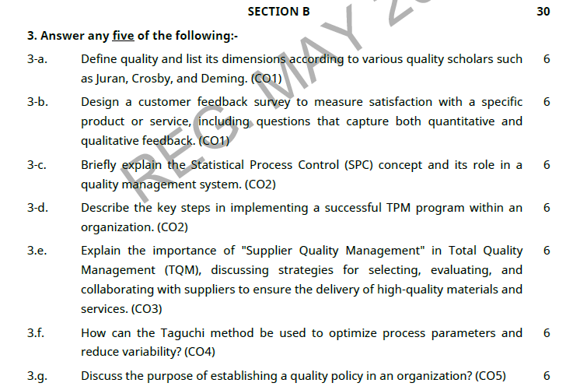
OLD QUESTION PAPERS

Slide 72
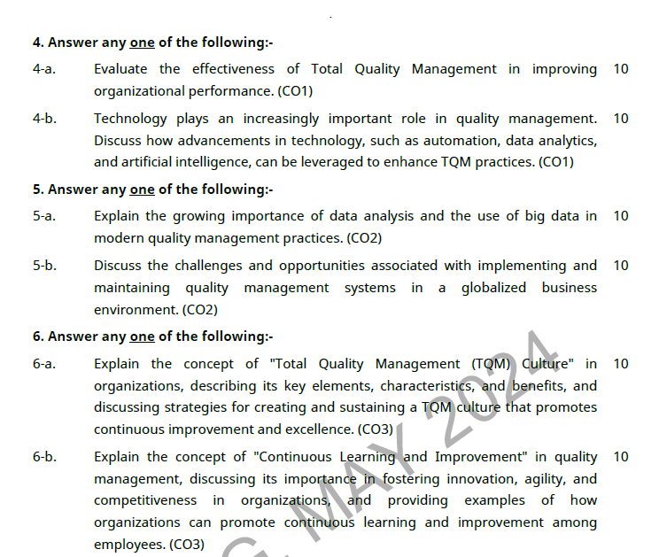
OLD QUESTION PAPERS

Slide 73
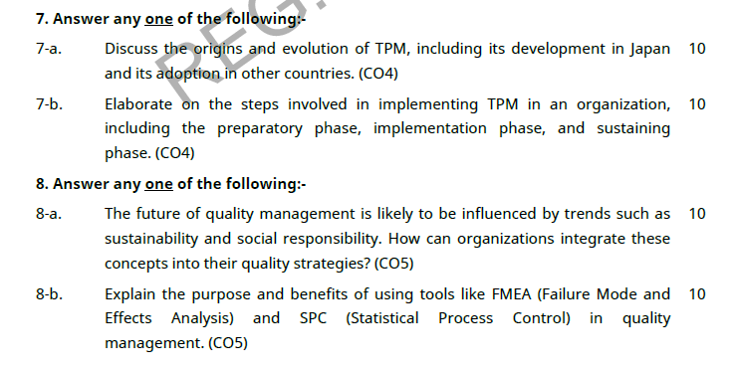
OLD QUESTION PAPERS

Slide 74
EXPECTED QUESTIONS FOR UNIVERSITY EXAM
Explain the reliability and factors affecting it.
Explain the procedure of calculation of reliability.
Explain quality circle in details.
What do you understand by quality function?
Explain PDCE cycle with example.
What is zero defect?
What is MTTF?
What are the phases of a Continuous Process Improvement Cycle?
Define 5S?
What is a Kaizen?

Slide 75
EXPECTED QUESTIONS FOR UNIVERSITY EXAM
11. What are the types of teams?
12. What are the stages of team development?
13. Give some common team problems?
14. Give the steps involved in training process?
15. What are the three components of the Juran Trilogy?
16. What are the phases of a Continuous Process Improvement Cycle?

Slide 76
REFERENCES
Text Book
Lt. Gen. H. Lal, “Total Quality Management”, Eastern Limited
Greg Bounds, “Beyond Total Quality Management”, McGraw Hill
Menon, H.G, “TQM in New Product manufacturing”, McGraw Hill
Reference Book
Total Quality Management” by Besterfield
“Total Quality Management” by Mukherjee
Total Quality Management” by Vijayan
“Total Quality Management- Text and Cases” by Janakiraman B and Gopal R K
https://www.researchgate.net/publication/318654507_Total_Quality_Management_Notes

Slide 77
Thank You

